Slide 1



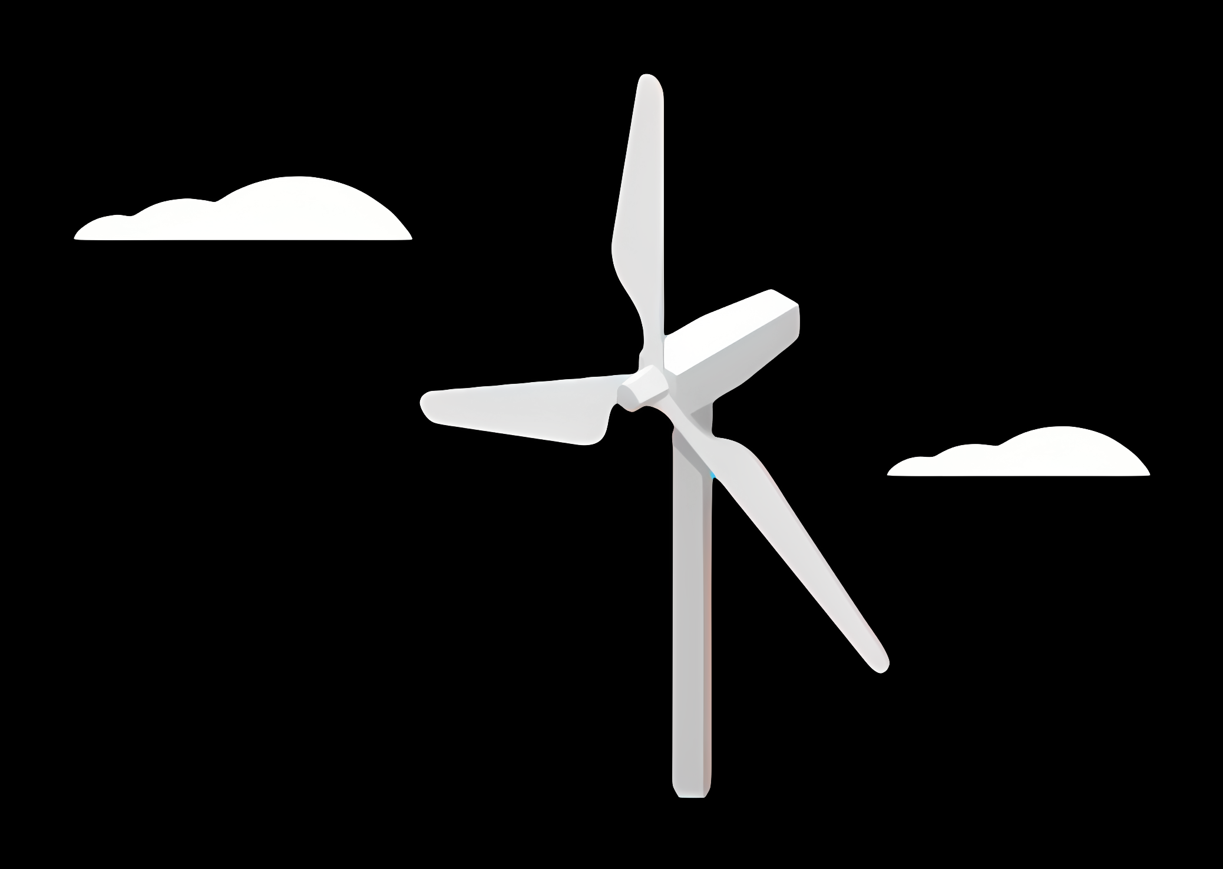
Weekly report: Load & Dynamics
Week number: 02
Date: 30/09/2025
Supervisor: Mr. Manjock
Group members: Md Aman

Slide 2
Agenda
Typical load output sections
Design situations
Simulation Workflow
Needed parameters for the pre-processing
Coordinate systems and components
Estimated Loads for Optimus Syria based on statistics.

Slide 3
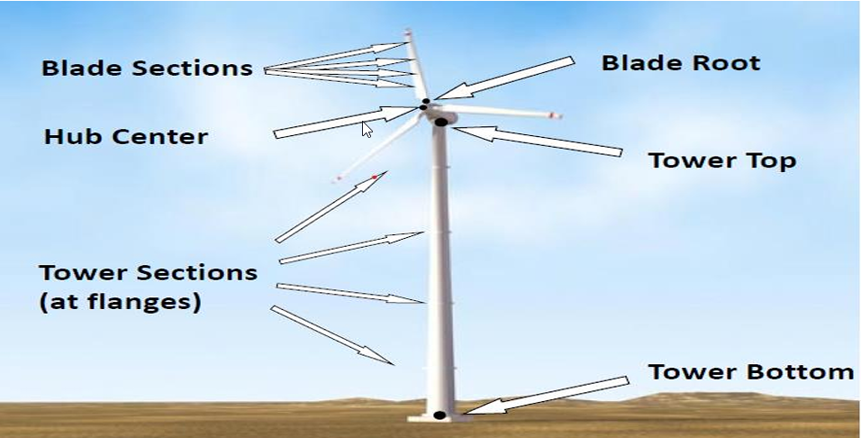
Typical load output sections
Load Output Sections Representation
Source : Load Simulation Seminar Mr. Manjock SS25

Slide 4
Design situations
Power production (DLC 1.X)
Power production + occurrence of fault (DLC 2.X)
Start up (DLC 3.X)
Normal shutdown(DLC 4.X)
Emergency stop (DLC 5.1)
Parked: Standing still or idling (DLC 6.X)
Parked and fault conditions (DLC 7.X)
Transport, installation, maintenance and repair (DLC 8.X)
Source :Loads and site conditions for wind turbines, DNVGL-ST-437,Edition November 2016

Slide 5
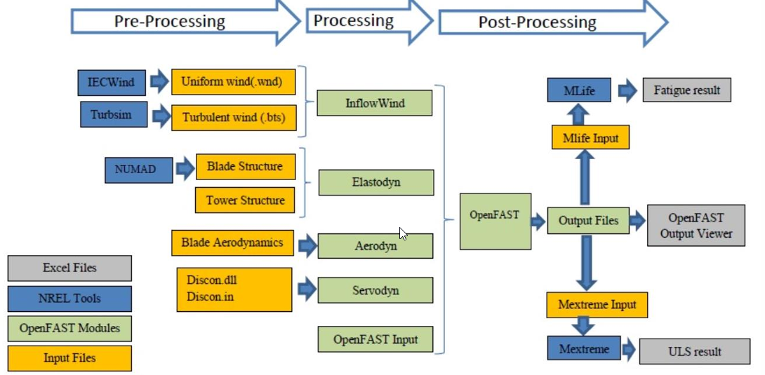
Simulation Workflow OpenFAST
Simulation Workflow
Source : Load report Optimus92 LE WS21

Slide 6
Needed parameters for the pre-processing
Site assessment:
Wind speed
Wind direction
Air density
Turbulence
Wind shear
Annual distribution
Tower:
Tower height
Mass distribution
Stiffness
Natural frequencies
Rotor blades:
Mass per unit length
Bending stiffness
Torsional stiffness
Natural frequencies
Material properties
Lift coefficient (Cl) and Drag coefficient (Cd) as functions of the angle of attack (AoA).
Blade twist and chord distribution along the blade.
Tip loss and hub loss correction factors
RNA Masses and inertias
Yaw bearing
Rotor Hub
Nacelle inertia about yaw axis
Generator
Control:
Pitch control gain values.
Generator torque control settings.
Set points for turbine operating conditions
Yaw control settings

Slide 7
Coordinate systems and components
Coordinate system | Affected components
Blade coordinate system | Rotor blade Rotor hub, Pitch system
Chord coordinate system | Rotor blade
Hub coordinate system | Rotor hub, Pitch system Rotor bearing system Gearbox, Brake, Coupling Machine Bed, Yaw system
Tower top coordinate system | Machine Bed, Yaw system Tower & Foundation
Support structure (tower) coordinate system | Tower & Foundation

Slide 8
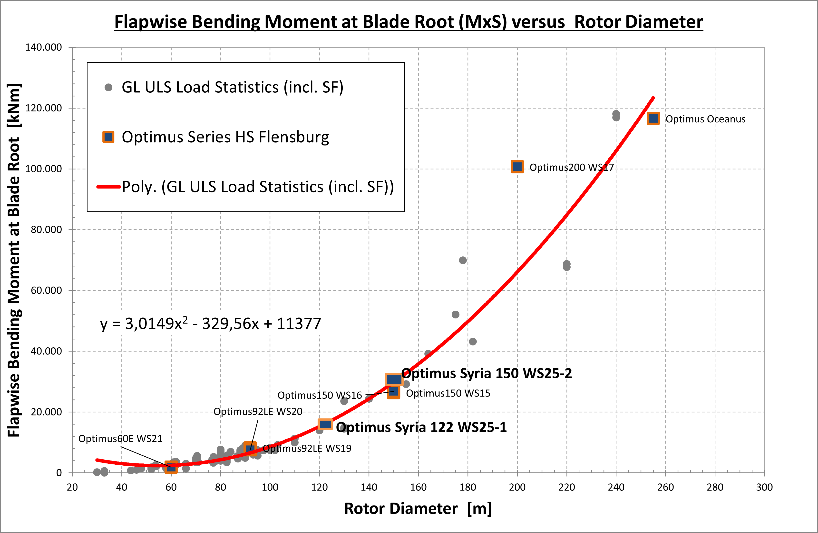
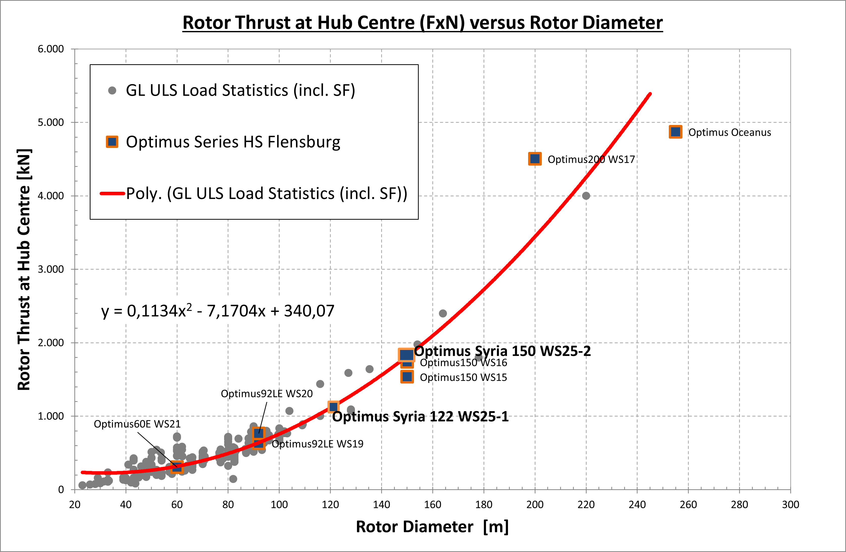
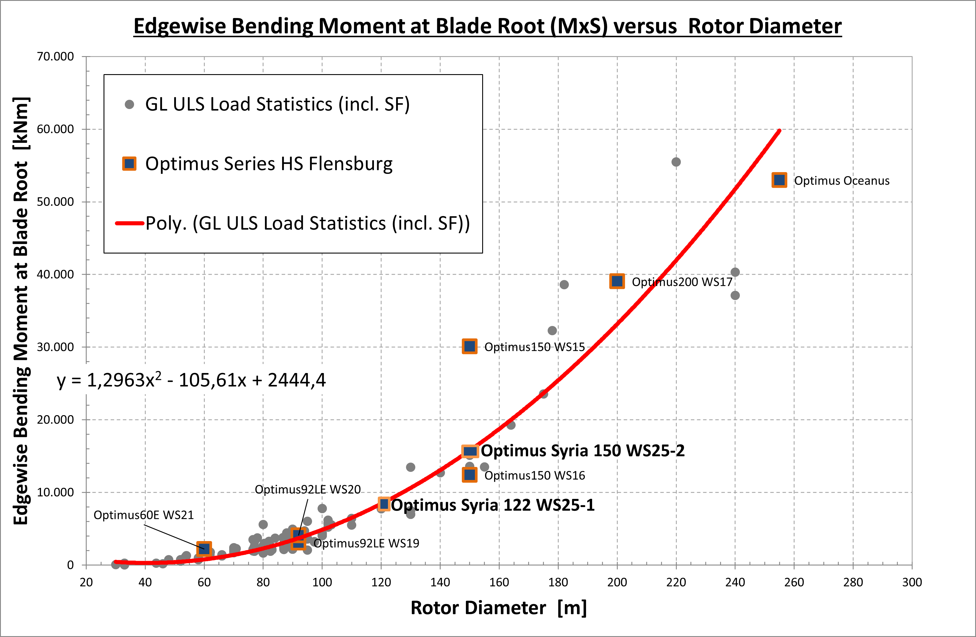
Estimated Extreme Loads for Optimus Syria

Slide 9
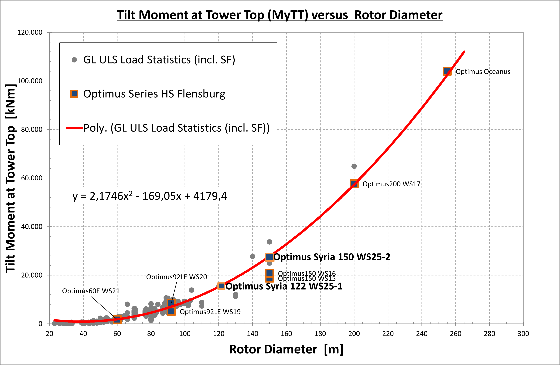
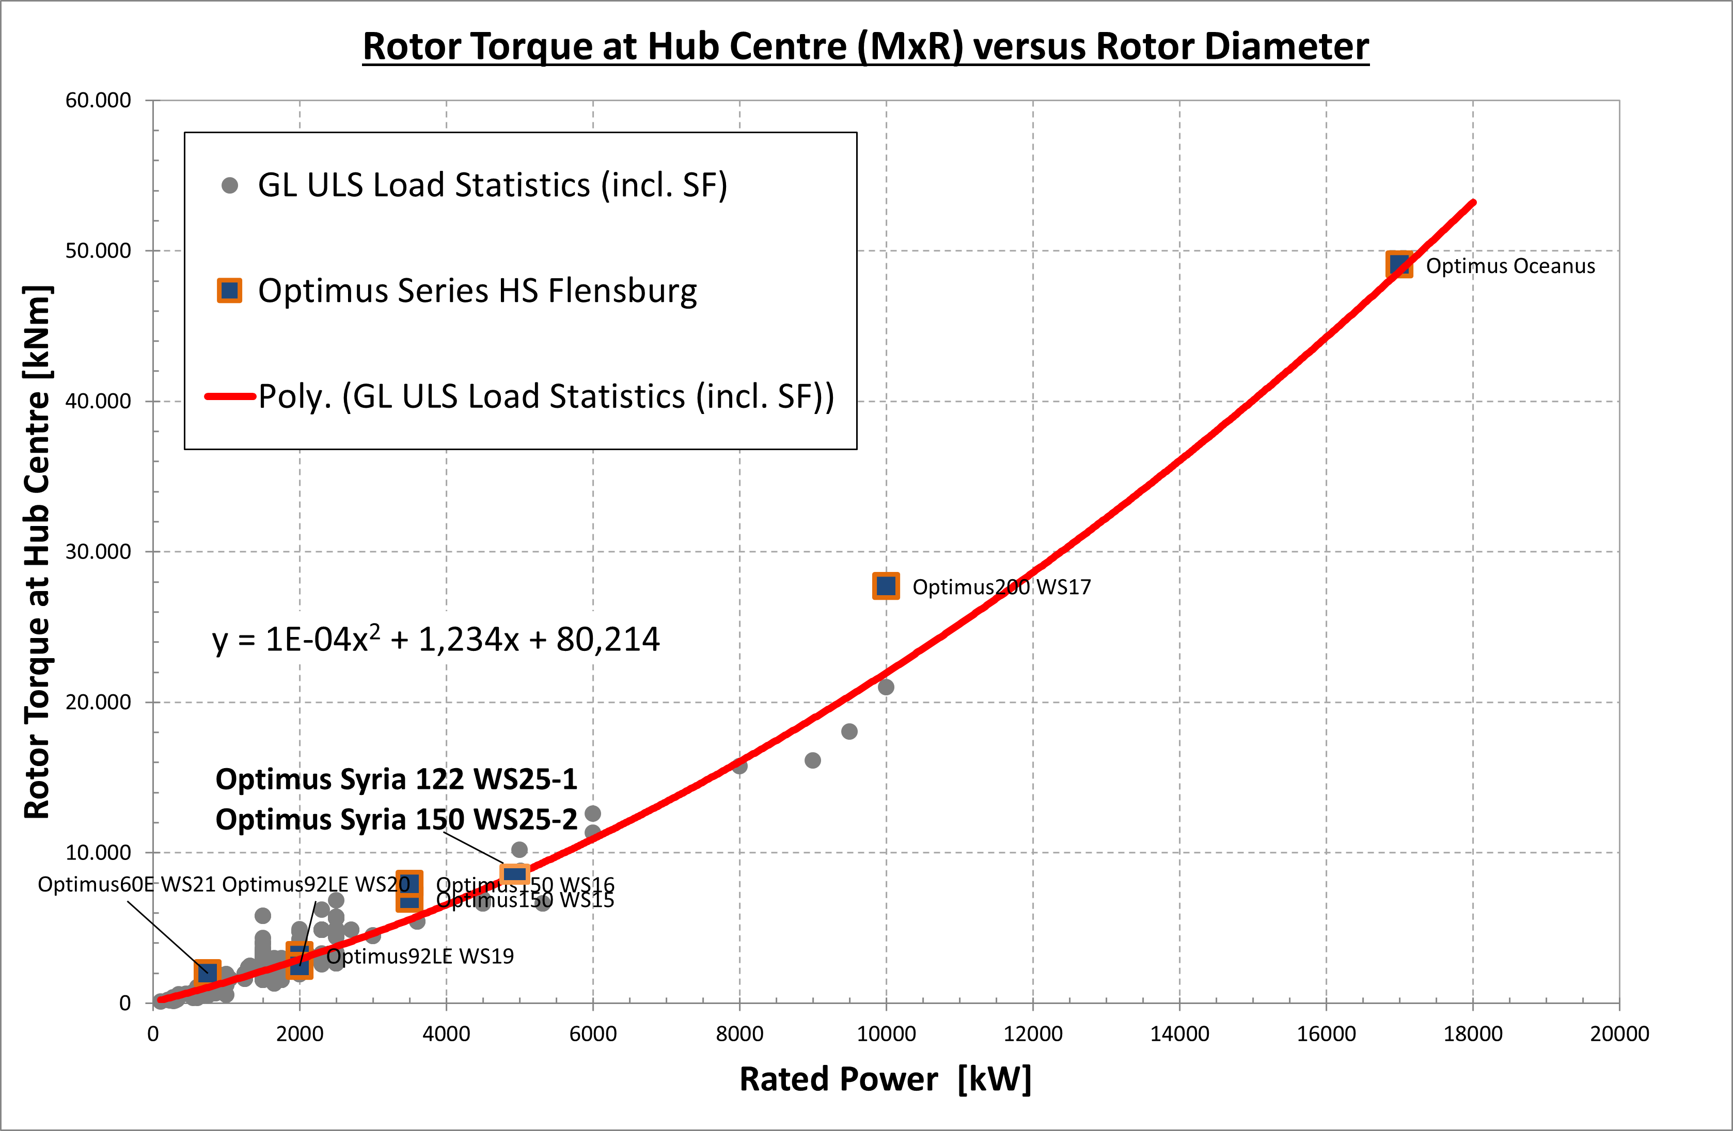
Estimated Extreme Loads for Optimus Syria

Slide 10
Estimated Extreme Loads for Optimus Syria
All values represent extreme loads (ULS) and already include the corresponding partial safety factors (γF).
 | Blade Edge moment | Blade Flap moment | Rotor thrust | Yaw Bearing Tilt moment | Rotor torque | Tower-bottom | Diameter | Tower height | Rated Power
 | kNm | kNm | kNm | kNm | kNm | kNm | m | m | KW
Optimus150 WS15 | 30,103 | 26,341 | 1,535 | 18,793 | 6,941 | 256,308 | 150 |  | 3,500
Optimus150 WS16 | 12,413 | 26,770 | 1,737 | 20,817 | 7,925 | 284,580 | 150 |  | 3,500
Optimus200 WS17 | 39,052 | 100,649 | 4,503 | 57,713 | 27,729 | 681,780 | 200 |  | 10,000
Optimus Oceanus | 52,998 | 116,570 | 4,872 | 103,990 | 49,073 | 1,189,800 | 255 |  | 17,000
Optimus92LE WS19 | 3,074 | 8,184 | 630 | 5,082 | 3,194 | 64,590 | 92 |  | 2,000
Optimus92LE WS20 | 4,070 | 7,495 | 764 | 8,432 | 2,471 | 86,020 | 92 |  | 2,000
Optimus60E WS21 | 2,204 | 1,872 | 304 | 1,708 | 2,005 | 28,567 | 60 |  | 750
Optimus Syria 1 | 8,854 | 16,044 | 1,153 | 15,922 | 8,500 | 120,000 | 122 | 90 | 5,000
Optimus Syria 2 | 15,769 | 29,778 | 1,816 | 27,750 | 8,500 | 28,2000 | 150 | 140 | 5,000

Slide 11
References
Load Reports of the OPTIMUS92 WS 21 projects
Loads and site conditions for wind turbines, DNVGL-ST-437,Edition November 2016
Load Simulation Seminar Mr. Manjock SS25

